Slide 1
RaiderNAV
brought to you by
Team Getana
Arpit Desai, Brody Williams, Michael Acosta, Vasilis Vloutis, Yong Wu

Slide 2
Table of Contents
Understanding the problems
Current efforts
Introducing RaiderNAV
Project objective
Target audience
Mockup
Overview of similar apps
Agile approach
Project timeline
Questions

Slide 3
Understanding the problems
01
Students (especially freshmen) have trouble finding classes.
TTU campus is very large.
Class schedules only provide building names (sometimes as acronyms!)
02
03

Slide 4
Current efforts
01
TTU has a static map on app and website
TTU has a touch-screen device in the Student Union Building
02
These efforts are not sufficient.

Slide 5
Introducing RaiderNAV
01
GPS navigation application for TTU students and visitors
Easy to edit, delete, or save multiple schedules
Time conscious: schedules/travel time
Support dynamic scheduling situations
02
03
04

Slide 6
Project objective
The RaiderNAV app is intended to provide college students at Texas Tech University with a better way to
find their classes,
navigate through campus,
and schedule their day.

Slide 7



Target audience
Students at Texas Tech University
Campus visitors

Slide 8
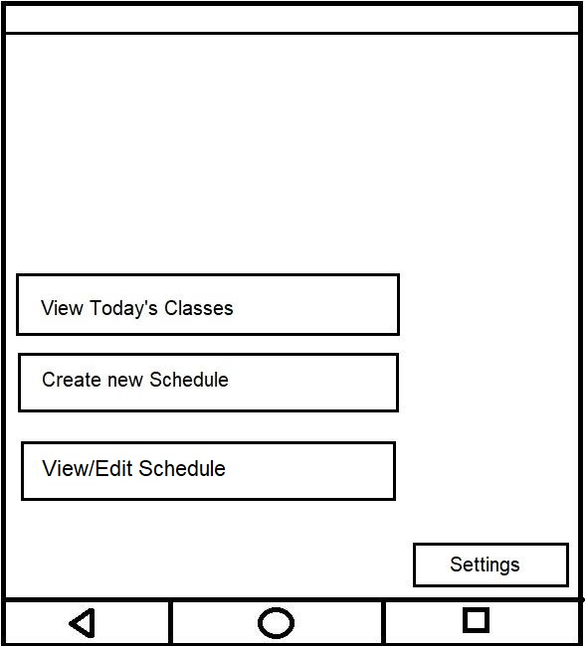
Mockup

Slide 9
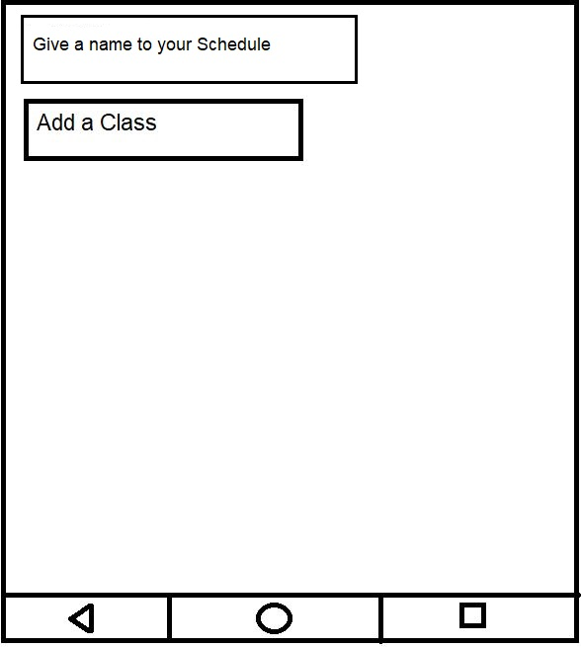
Creating a Schedule

Slide 10
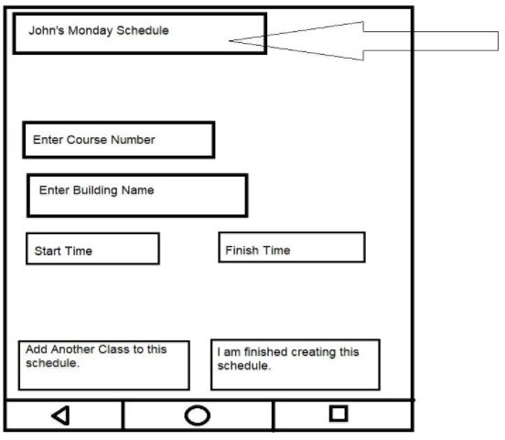
Enter the course classes and information

Slide 11
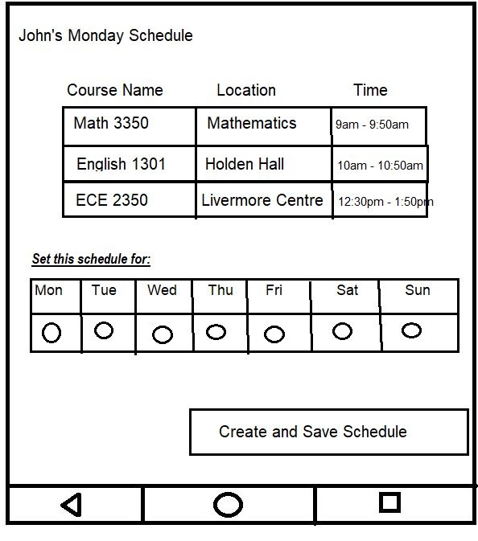
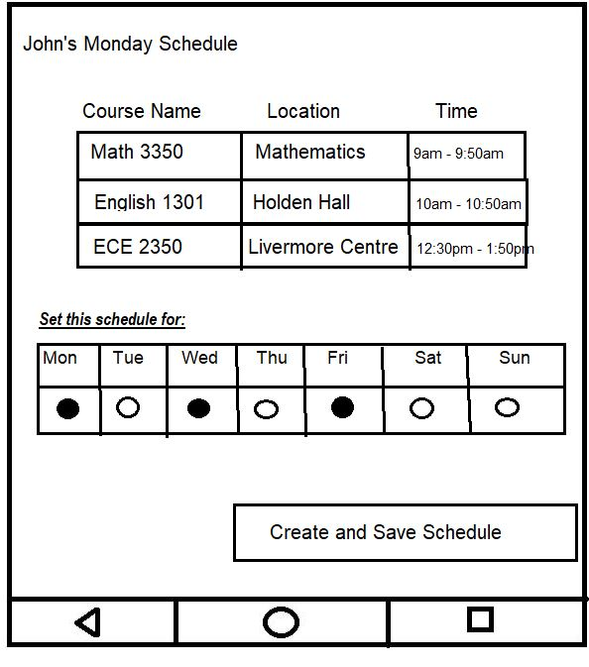
Repeating the Schedule

Slide 12
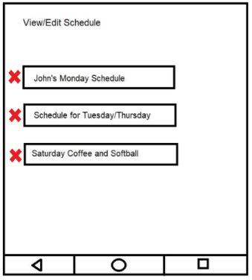
View/Edit Schedule

Slide 13
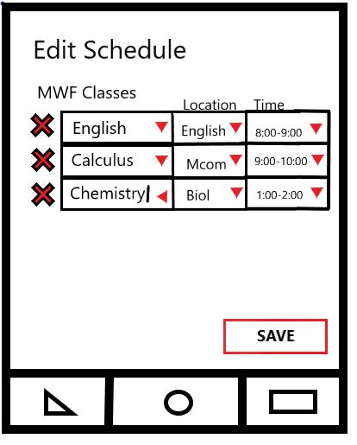
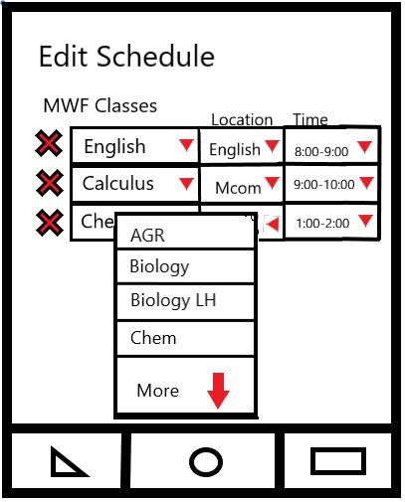
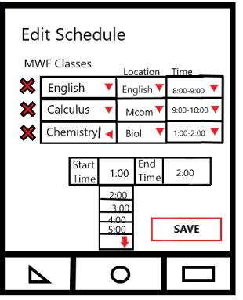
Editing the Schedule

Slide 14
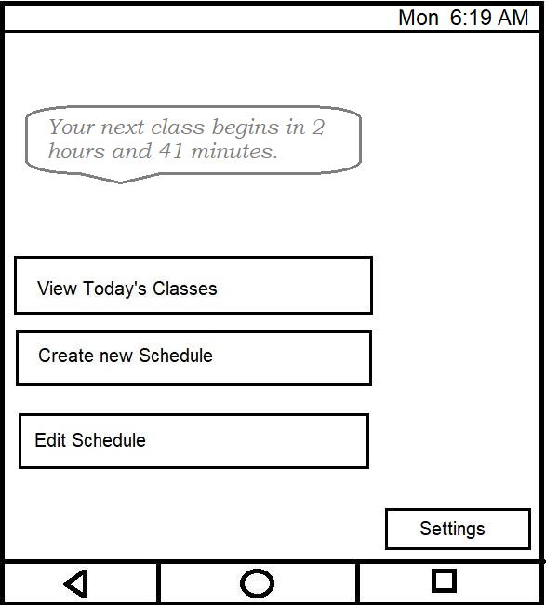
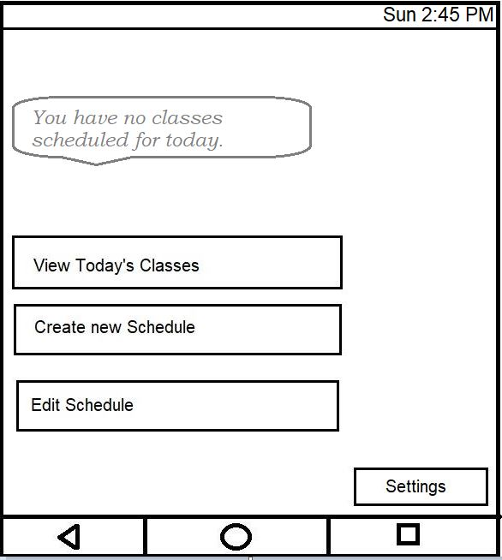
Notifications

Slide 15
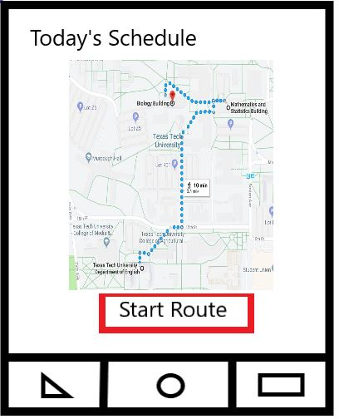
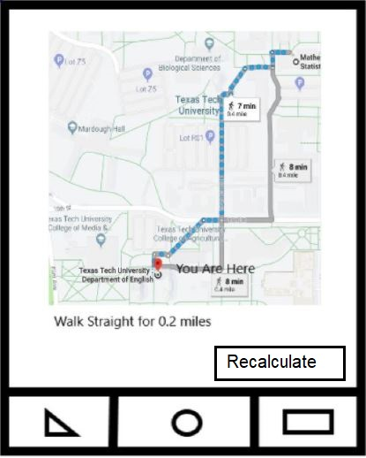
Today’s Schedule

Slide 16
Overview of similar apps
Google Maps
Texas Tech Mobile
My Class Schedule: Timetable

Slide 17
Google Maps
Standard in real-time GPS navigation
Traffic condition information
Public transportation
Pit stops
Discover nearby places
Reviews and detailed business information
Internet connection optional

Slide 18
Google Maps (cont.)
Not tailored to Texas Tech
Students may not know addresses of buildings on schedule
Students may not know names of the buildings on schedule
Must tediously input destinations one by one
Does not keep track of class times
Does not keep student informed about danger of running late

Slide 19
Texas Tech Mobile
Keeps track of athletics schedules and scores
Class registration status
Directory search by first and last name
Campus map
List of events from the TTU calendar,
News from TechAnnounce and the Daily Toreador
Browse the library catalog

Slide 20
Texas Tech Mobile (cont.)
Has only a static map of the campus.
The student who must rely on the Texas Tech Mobile app to quickly find a building is doomed to failure.

Slide 21
My Class Schedule: Timetable
Class schedule in color-coded timetable
Overview of grades
Mutes phone during class hours
Widget displays all remaining classes for the day
Reminds students about upcoming homework and exams.

Slide 22
My Class Schedule: Timetable (cont.)
Not tailored to Texas Tech University
Does not provide maps
Cannot help lost students get to class on time

Slide 23
Agile approach
04
Plan
Evaluate
01
03
Develop and Integrate
Release
02

Slide 24
Project timeline
JAN
FEB
MAR
APR
MAY
Conception
Documentation
Deliverable 2
Deliverable 3
Product Launch
Application development begins

Slide 25

Thank you!
Any questions?

